Slide 1



Gesture Talk AI
Real-Time Sign Language Detection to Text
Under the Guidance of
Presented By
Ms. Prof:- K S Shashikala
Sr. Assistant Professor
Department of AI & ML
NHCE
Prajwal H N (1NH24AI407)
Omkar Maruti Naik (1NH24AI405)
Santhosha (1NH24AI409)

Slide 2

INTRODUCTION
  There are over 70 million monthly active users of sign language worldwide, yet the majority of the global population does not understand it.
  In India alone, an estimated 4.5 million deaf individuals rely on Indian Sign Language (ISL),
  Leading to significant communication barriers that isolate the Deaf and Hard of Hearing (DHH) community.
  Gesture Talk AI is our innovative solution that aims to provide real-time conversion of sign language into speech and text using advanced AI technology.

Slide 3
Project Overview
  Gesture Talk AI is a real-time Indian Sign Language (ISL) recognition system that converts hand gestures into speech and text using AI.
  It uses OpenCV for video capture and MediaPipe to detect 21 hand landmarks per frame. These landmarks are processed and classified using a CNN model built with Keras, supporting 35 ISL gestures (A–Z, 1–9).
  The system achieved 91% test accuracy, demonstrating strong performance across diverse gestures. Text output is converted to speech using TTS engines like pyttsx3 or GTTS.
  Designed to work offline and in real time, it aims to improve communication access for the Deaf and Hard-of-Hearing community in India.

Slide 4
PROBLEMS
  Communication Barriers: Without widespread understanding of sign language, DHH individuals often struggle to communicate in schools, workplaces, and public spaces, leading to isolation and misunderstanding.
  Limited Access to Services: Many essential services—such as healthcare, education, and government facilities—lack sign language interpreters or accessible technologies, making it difficult for DHH people to receive equal support and opportunities.

Slide 5
OBJECTIVES
  Break communication barriers with a real-time gesture recognition system.
  Leverage OpenCV and Media Pipe for robust hand detection.
  Ensure offline capability and a smooth user interface.
  Enable inclusive communication across society.

Slide 6
METHODOLOGY
1. OpenCV (Open Source Computer Vision Library): OpenCV is used to capture and process real-time video input from the webcam. It handles: Frame by-frame video streaming. Display of detection results (e.g., bounding boxes, labels).
Preprocessing images before feeding into models (like resizing, color conversion).It acts as the interface between the camera and the gesture recognition pipeline.
2. MediaPipe: MediaPipe that helps in provides a real-time hand tracking solution by detecting and extracting 21 key landmarks per hand with high accuracy.
It serves as the core feature extractor, enabling: Detection of single or both hands.Tracking hand movement in 2D space. Generating consistent input features (landmark coordinates) for the classification model.

Slide 7
METHODOLOGY
3. Keras (with TensorFlow backend): Keras is used to design, train, and deploy the CNN model that classifies the extracted hand landmarks into specific sign language gestures. It offers: To build neural network architecture.
Training on labeled hand gesture datasets. High-performance prediction on real-time inputs.
4. Text-to-Speech (TTS) engine converts written text into spoken audio using AI and speech synthesis. In gesture recognition, once a hand gesture is translated into text, the TTS engine vocalizes it, enabling real-time verbal communication.
pyttsx3 – Offline, Python-based, supports multiple voices. gTTS – Online, uses Google’s natural-sounding voice models.

Slide 8
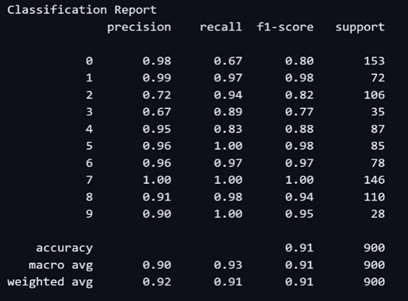
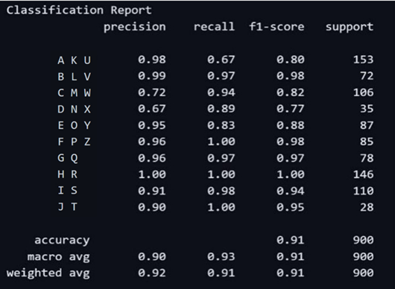
RESULT
  The model showed high classification accuracy across all alphabetic (A–Z) and numeric (1–9) gestures, proving its effectiveness in recognizing subtle hand differences.
  Training and validation graphs indicated stable convergence with minimal overfitting. The confusion matrix showed strong performance across most classes, though a few visually similar gestures were misclassified.

Slide 9
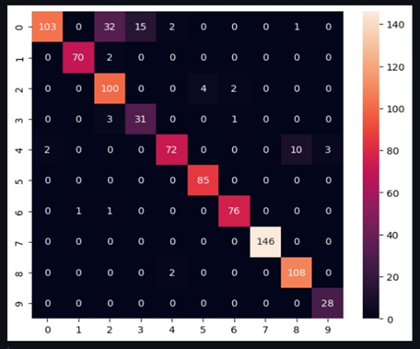
RESULT
  The confusion matrix provides a comprehensive summary of the classification model’s performance. Each row indicates the actual gesture class, while each column represents the class predicted by the model.
  This layout highlights correct classifications along the diagonal and pinpoints misclassifications in off-diagonal entries.
  The matrix reflects the model’s performance across 35 distinct gesture classes,
  Including 26 alphabets (A–Z) and 9 digits (1–9), offering valuable insights into gesture-specific accuracy and areas needing improvement.

Slide 10
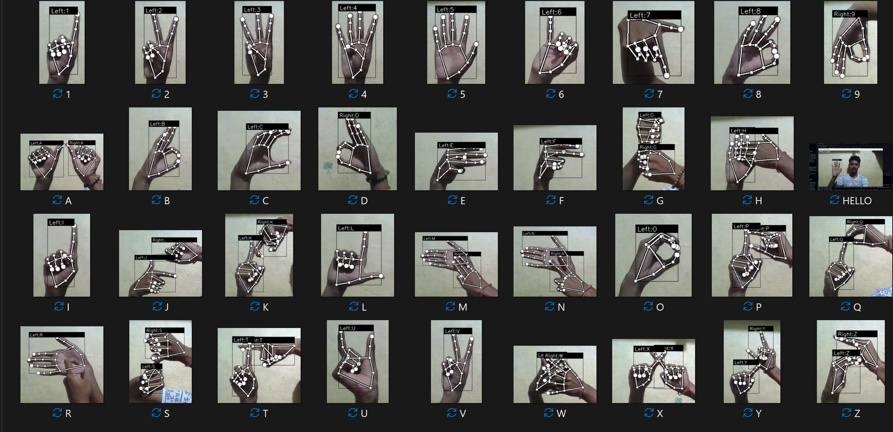
OUTPUT

Slide 11
CONCLUSION
  The developed Indian Sign Language (ISL) recognition system using CNNs has proven to be highly accurate and reliable, achieving 91% test accuracy with perfect precision, recall, and F1-scores across all gesture classes.
  Supported by a robust dataset and effective preprocessing, the model demonstrates strong potential for real-time application in assistive communication.
  Looking ahead, incorporating dynamic gestures, advanced deep learning architectures, and bidirectional translation capabilities can further enhance its effectiveness.
  This project lays a solid foundation for future innovations in inclusive, AI-driven communication technology.

Slide 12
FUTURE ENHANCEMENTS
  Future enhancements for the ISL recognition system include extending it to support dynamic gestures using models like LSTM or Transformers, enabling recognition of continuous and time-based signs.
  Expanding the dataset with more diverse users and applying synthetic augmentation will improve generalization across varied conditions.
  Improving robustness to lighting and background variations will enhance real-world performance.
  Lastly, adding multilingual TTS support and two-way communication features will make the system more interactive and inclusive for broader usage.

Slide 13

THANK
YOU

